Slide 1

Python Inheritance
Made by Alexander skadal kyrkjeeide

Slide 2
What is Python Inheritance?
Is a mechanism that allows a new class to be based on an existing class
Inherits all the attributes and methods of the original class
Parent class is the class being inherited from, base class
The Child class is the class that inherits from another class, derived class

Slide 3

Why do we use Python Inheritance?
Inheritance allows to reuse code from existing classes, reducing the amount of code we need to write and increasing code modularity
Inheritance allows us to define a hierarchy of classes with similar attributes and behaviors, making it easier to write more general and flexible code
Inheritance enables us to create new classes that are variations of existing classes, adding new functionality or modifying existing behavior (extend its features)

Slide 4
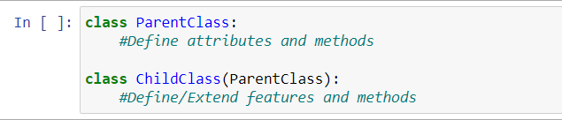
How do we use Python Inheritance?
Need to define a new class that inherits from an existing class using the ‘class‘ keyword and the parent class name in parentheses after the child class name:

Slide 5
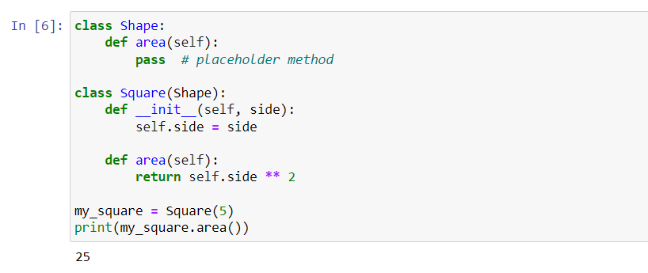
Example of Python Inheritance

